Slide 1
UNIT-1
INTRODUCTION
Notes:
Prepared By: Rajesh Kannan K, IT Dept. CBIT

Slide 2
DATABASE MANAGEMENT SYSTEMS
A database-management system (DBMS) is a collection of interrelated data and a set of programs to access those data.
The collection of data, usually referred to as the database, contains information relevant to an enterprise.
Goal:
DBMS is to provide a way to store and retrieve database information that is both convenient and efficient.

Slide 3
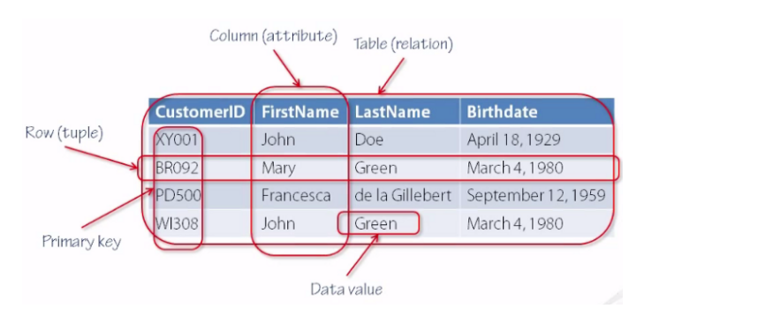
DATABASE MANAGEMENT SYSTEMS
Y.GnyanaDeepa

Slide 4
DATABASE MANAGEMENT SYSTEMS
Database systems are designed to manage large bodies of information.
Management of data involves both defining structures for storage of information and providing mechanisms for the manipulation of information.
In addition, the database system must ensure the safety of the information stored, despite system crashes or attempts at unauthorized access.
Y.GnyanaDeepa

Slide 5
DATABASE SYSTEM APPLICATIONS
Banking
Airlines
Universities
Credit card transactions
Telecommunication
Finance
Sales
Manufacturing
Human resources
Y.GnyanaDeepa

Slide 6
PURPOSE OF DATABASE SYSTEMS
Consider part of a savings-bank enterprise that keeps information about all customers and savings accounts.
One way to keep the information on a computer is to store it in operating system files.
To allow users to manipulate the information, the system has a number of application programs that manipulate the files.
System programmers wrote these application programs to meet the needs of the bank.
New application programs are added to the system as the need arises.
Y.GnyanaDeepa

Slide 7
PURPOSE OF DATABASE SYSTEMS
A program to debit or credit an account
A program to add a new account
A program to find the balance of an account
A program to generate monthly statements
Y.GnyanaDeepa

Slide 8
DATABASE SYSTEMS VERSUS FILE SYSTEMS
Before database management systems (DBMSs) came along, organizations usually stored information in File systems.
This typical file-processing system is supported by a conventional operating system.
Y.GnyanaDeepa
1 CBIT
1 | CBIT
FILE SYSTEM(NTFS)
FILE SYSTEM(NTFS)
HARD DISK
HARD DISK

Slide 9
DATABASE SYSTEMS VERSUS FILE SYSTEMS
Data redundancy and inconsistency.
Since different programmers create the files and application programs over a long period, the various files are likely to have different formats and the programs may be written in several programming languages. Moreover, the same information may be duplicated in several places (files).
Y.GnyanaDeepa

Slide 10
DATABASE SYSTEMS VERSUS FILE SYSTEMS
Difficulty in accessing data.
Suppose that one of the bank officers needs to find out the names of all customers who live within a particular postal-code area.
The bank officer has now two choices: either obtain the list of all customers and extract the needed information manually or ask a system programmer to write the necessary application program.
Both alternatives are obviously unsatisfactory
Y.GnyanaDeepa

Slide 11
DATABASE SYSTEMS VERSUS FILE SYSTEMS
Data isolation.
Because data are scattered in various files, and files may be in different formats, writing new application programs to retrieve the appropriate data is difficult.
Y.GnyanaDeepa

Slide 12
DATABASE SYSTEMS VERSUS FILE SYSTEMS
Integrity problems.
The data values stored in the database must satisfy certain types of consistency constraints.
For example, the balance of a bank account may never fall below a prescribed amount (say, $25). Developers enforce these constraints in the system by adding appropriate code in the various application programs.
However, when new constraints are added, it is difficult to change the programs to enforce them.
Y.GnyanaDeepa

Slide 13
DATABASE SYSTEMS VERSUS FILE SYSTEMS
Atomicity problems.
if a failure occurs, the data be restored to the consistent state that existed prior to the failure.
Consider a program to transfer $50 from account A to account B.
If a system failure occurs during the execution of the program, it is possible that the $50 was removed from account A but was not credited to account B, resulting in an inconsistent database state.
Y.GnyanaDeepa

Slide 14
DATABASE SYSTEMS VERSUS FILE SYSTEMS
Concurrent-access anomalies
For the sake of overall performance of the system and faster response, many systems allow multiple users to update the data simultaneously.
In such an environment, interaction of concurrent updates may result in inconsistent data.
Y.GnyanaDeepa

Slide 15
DATABASE SYSTEMS VERSUS FILE SYSTEMS
Consider bank account A, containing $500. If two customers withdraw funds (say $50 and $100 respectively) from account A at about the same time.
If the two programs run concurrently, they may both read the value $500, and write back $450 and $400, respectively.
Depending on which one writes the value last, the account may contain either $450 or $400, rather than the correct value of $350.
Y.GnyanaDeepa

Slide 16
DATABASE SYSTEMS VERSUS FILE SYSTEMS
Security problems.
Not every user of the database system should be able to access all the data.
For example, in a banking system, payroll personnel need to see only that part of the database that has information about the various bank employees.
They do not need access to information about customer accounts.
But, since application programs are added to the system in an ad hoc manner, enforcing such security constraints is difficult.
Y.GnyanaDeepa

Slide 17
VIEW OF DATA
A database system is a collection of interrelated files and a set of programs that allow users to access and modify these files.
A major purpose of a database system is to provide users with an abstract view of the data. That is, the system hides certain details of how the data are stored and maintained.
Y.GnyanaDeepa

Slide 18
DATA ABSTRACTION
Database systems are made-up of complex data structures. To ease the user interaction with database, the developers hide internal irrelevant details from users.
This process of hiding irrelevant details from user is called data abstraction.
There are mainly 3 levels of data abstraction:
3. View Level
2. Logical Level (Conceptual Level)
1. Physical Level
Y.GnyanaDeepa

Slide 19
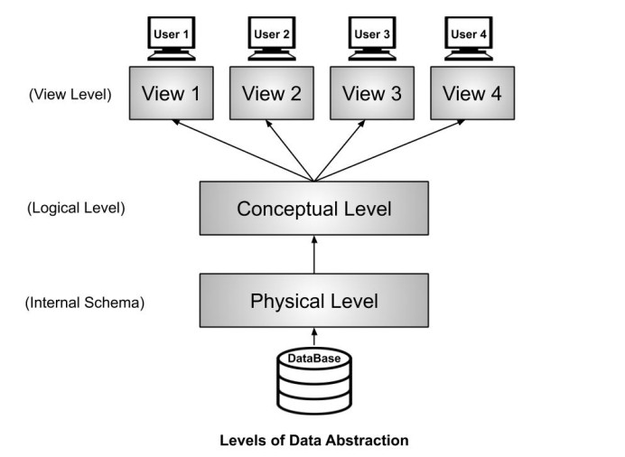
DATA ABSTRACTION
Y.GnyanaDeepa

Slide 20
DATA ABSTRACTION
Physical level.
The lowest level of abstraction describes how the data are actually stored. The physical level describes complex low-level data structures in detail.
Logical level.
The next-higher level of abstraction describes what data are stored in the database, and what relationships exist among those data.
Y.GnyanaDeepa

Slide 21
DATA ABSTRACTION
View level.
The highest level of abstraction describes only part of the entire database.
Even though the logical level uses simpler structures, complexity remains because of the variety of information stored in a large database.
The view level of abstraction exists to simplify the users interaction with the system.
Y.GnyanaDeepa

Slide 22
DATA ABSTRACTION
Example: Let’s say we are storing customer information in a customer table. At physical level these records can be described as blocks of storage (bytes, gigabytes, terabytes etc.) in memory. These details are often hidden from the programmers.
At the logical level these records can be described as fields and attributes along with their data types, their relationship among each other can be logically implemented. The programmers generally work at this level because they are aware of such things about database systems.
At view level, user just interact with system with the help of GUI and enter the details at the screen, they are not aware of how the data is stored and what data is stored; such details are hidden from them.
Y.GnyanaDeepa

Slide 23
INSTANCES AND SCHEMAS
Databases change over time as information is inserted and deleted.
The collection of information stored in the database at a particular moment is called an instance of the database.
The overall design of the database is called the database schema.
Y.GnyanaDeepa

Slide 24
INSTANCES AND SCHEMAS
Database systems have several schemas, partitioned according to the levels of abstraction.
Physical Schema describes the database design at the physical level.
Logical Schema describes the database design at the logical level.
A database may also have several schemas at the view level, sometimes called sub schemas, that describe different views of the database.
Y.GnyanaDeepa

Slide 25
INSTANCES AND SCHEMAS
Physical Data Independence :
Physical Data Independence is defined as the ability to make changes in the structure of the lowest level of the Database Management System (DBMS) without affecting the higher-level schemas.
Logical Data Independence :
Logical Data Independence is defined as the ability to make changes in the structure of the middle level of the Database Management System (DBMS) without affecting the highest-level schema or application programs.
Y.GnyanaDeepa

Slide 26
DATA MODELS
A data model is a collection of conceptual tools for describing data, data relationships, data semantics, and consistency constraints.
A Data Model provides a way to describe the design of a database at the physical, logical and view level.
The Data Model classified into four categories.
1. Relational Model
2. The Entity –Relationship Model
3. Object – Based Data Model
4. Semi structured Data Model
Y.GnyanaDeepa

Slide 27
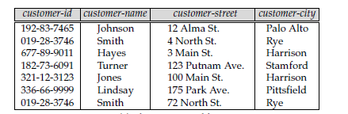
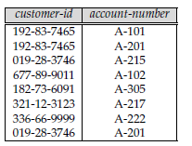
RELATIONAL MODEL
The Relational Model uses a collection of tables to represent both data and the relationships among those data. Each table has multiple columns, and each column has a unique name.
Y.GnyanaDeepa

Slide 28
RELATIONAL MODEL
The relational model is an example of a record-based model.
Because the database is structured in fixed-format records of several types.
Each table contains records of a particular type.
Each record type defines a fixed number of fields, or attributes.
The columns of the table correspond to the attributes of the record type.
Y.GnyanaDeepa

Slide 29
THE ENTITY-RELATIONSHIP MODEL
The entity-relationship (E-R) data model is based on a perception of a real world that consists of a collection of basic objects, called entities, and of relationships among these objects.
An entity is a “thing” or “object” in the real world that is distinguishable from other objects.
For example, each person is an entity, and bank accounts can be considered as entities.
Y.GnyanaDeepa

Slide 30
THE ENTITY-RELATIONSHIP MODEL
A relationship is an association among several entities.
The overall logical structure of a database can be expressed graphically by an E-R diagram, which is built up from the following components:
Rectangles- which represent entity sets.
Ellipses- which represent attributes.
Diamonds- which represent relationships among entity sets.
Lines- which link attributes to entity sets and entity sets to relationships.
Y.GnyanaDeepa

Slide 31
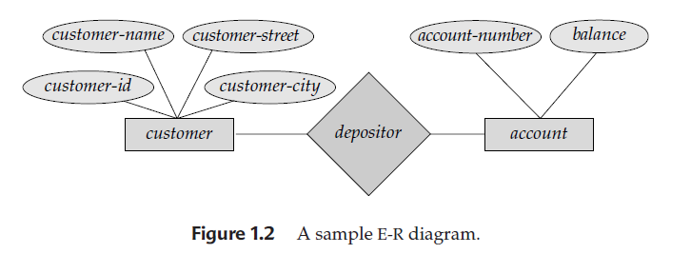
THE ENTITY-RELATIONSHIP MODEL
Y.GnyanaDeepa

Slide 32
OBJECT-ORIENTED DATA MODEL
The object-oriented data model is another data model that has seen increasing attention.
The object-oriented model can be seen as extending the E-R model with notions of encapsulation, methods (functions), and object identity.
Y.GnyanaDeepa

Slide 33
SEMI STRUCTURED DATA MODELS
Semi structured data models permit the specification of data where individual data items of the same type may have different sets of attributes.
The extensible markup language (XML) is widely used to represent semi structured data.
Historically, two other data models, the network data model and the hierarchical data model, preceded the relational data model.
These models were tied closely to the underlying implementation, and complicated the task of modelling data.
Y.GnyanaDeepa

Slide 34
DATABASE LANGUAGES
A database system provides a data definition language to specify the database schema and a data manipulation language to express database queries and updates.
Data-Manipulation Language
A data-manipulation language (DML) is a language that enables users to access or manipulate data as organized by the appropriate data model.
Retrieval of information stored in the database
Insertion of new information into the database
Deletion of information from the database
Modification of information stored in the database
Y.GnyanaDeepa

Slide 35
DATABASE LANGUAGES
Procedural DMLs require a user to specify what data are needed and how to get those data.
Declarative DMLs (also referred to as nonprocedural DMLs) require a user to specify what data are needed without specifying how to get those data.
A query is a statement requesting the retrieval of information.
The portion of a DML that involves information retrieval is called a query language.
Y.GnyanaDeepa

Slide 36
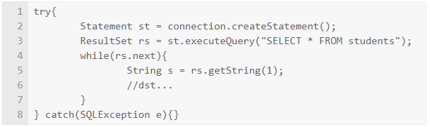
DATABASE LANGUAGES
Procedural DMLs
Nonprocedural DMLs
Y.GnyanaDeepa

Slide 37
DATABASE LANGUAGES
Data-Definition Language
Database schema by a set of definitions expressed by a special language called a data-definition language (DDL). The DDL is also used to specify additional properties of the data.
The storage structure and access methods used by the database system by a set of statements in a special type of DDL called a data storage and definition language.
Y.GnyanaDeepa

Slide 38
DATABASE LANGUAGES
Data-Definition Language
The data values stored in the database must satisfy certain consistency constraints.
For example, suppose the university requires that the account balance of a department must never be negative. The DDL provides facilities to specify such constraints.
Domain Constraints
Referential Integrity
Assertions.
Authorization.
Y.GnyanaDeepa

Slide 39
DATABASE LANGUAGES
Domain Constraints.
A domain of possible values must be associated with every attribute.
For example, integer types, character types, date/time types.
Declaring an attribute to be of a particular domain acts as a constraint on the values that it can take.
Y.GnyanaDeepa

Slide 40
DATABASE LANGUAGES
Referential Integrity.
There are cases where we wish to ensure that a value that appears in one relation for a given set of attributes also appears in a certain set of attributes in another relation (referential integrity).
Database modifications can cause violations of referential integrity.
When a referential-integrity constraint is violated, the normal procedure is to reject the action that caused the violation.
Y.GnyanaDeepa

Slide 41
DATABASE LANGUAGES
Assertions.
An assertion is any condition that the database must always satisfy.
Domain constraints and referential-integrity constraints are special forms of assertions.
For example, “Every department must have at least five courses offered every semester” must be expressed as an assertion.
When an assertion is created, the system tests it for validity.
If the assertion is valid, then any future modification to the database is allowed only if it does not cause that assertion to be violated.
Y.GnyanaDeepa

Slide 42
DATABASE LANGUAGES
Authorization.
We may want to differentiate among the users as far as the type of access they are permitted on various data values in the database.
read authorization, which allows reading, but not modification, of data.
insert authorization, which allows insertion of new data, but not modification of existing data.
update authorization, which allows modification, but not deletion, of data.
delete authorization, which allows deletion of data.
Y.GnyanaDeepa

Slide 43
DATABASE LANGUAGES
The DDL, just like any other programming language, gets as input some instructions (statements) and generates some output.
The output of the DDL is placed in the data dictionary, which contains metadata—that is, data about data.
The data dictionary is considered to be a special type of table that can only be accessed and updated by the database system itself (not a regular user).
The database system consults the data dictionary before reading or modifying actual data.
Y.GnyanaDeepa

Slide 44
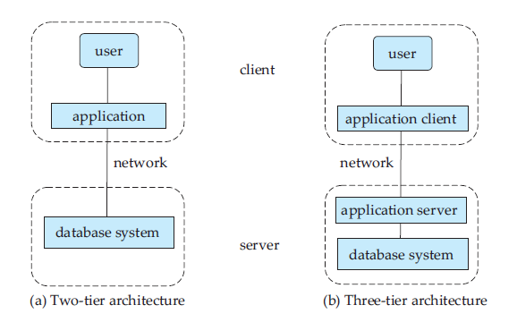
DATABASE ARCHITECTURE
Y.GnyanaDeepa

Slide 45
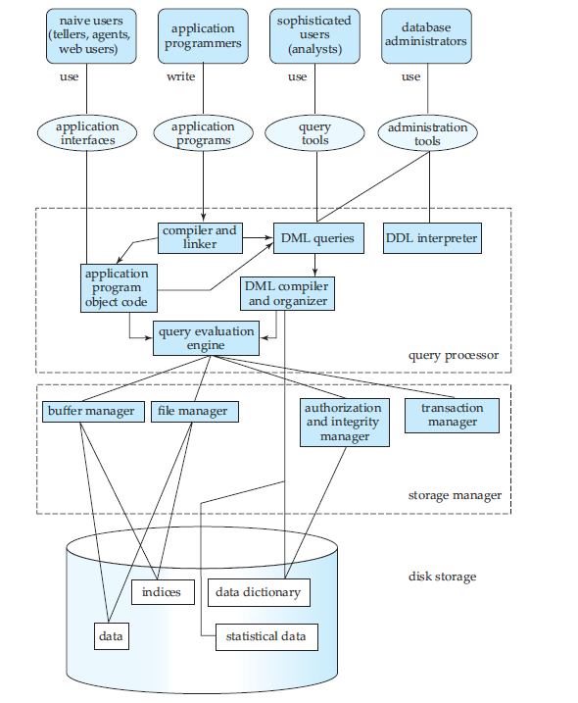
DATABASE ARCHITECTURE
Y.GnyanaDeepa

Slide 46
DATABASE ARCHITECTURE
Database Users and Administrators
A primary goal of a database system is to retrieve information from and store new information into the database.
People who work with a database can be categorized as database users or database administrators.
There are four different types of database-system users.
Naive users
Application programmers
Sophisticated users
Specialized users
Y.GnyanaDeepa

Slide 47
DATABASE ARCHITECTURE
Naive users are unsophisticated users who interact with the system by invoking one of the application programs that have been written previously.
For example, a clerk in the university who needs to add a new instructor to department A invokes a program called new hire. This program asks the clerk for the name of the new instructor, her new ID, the name of the department (that is, A), and the salary.
The typical user interface for naive users is a forms interface, where the user can fill in appropriate fields of the form. Naive users may also simply read reports generated from the database.
Y.GnyanaDeepa

Slide 48
DATABASE ARCHITECTURE
Application programmers are computer professionals who write application programs.
Application programmers can choose from many tools to develop user interfaces.
Rapid application development (RAD) tools are tools that enable an application programmer to construct forms and reports with minimal programming effort.
Y.GnyanaDeepa

Slide 49
DATABASE ARCHITECTURE
Sophisticated users interact with the system without writing programs.
Instead, they form their requests either using a database query language or by using tools such as data analysis software.
Analysts who submit queries to explore data in the database fall in this category.
Y.GnyanaDeepa

Slide 50
DATABASE ARCHITECTURE
Specialized users are sophisticated users who write specialized database applications that do not fit into the traditional data-processing framework.
Among these applications are computer-aided design systems, knowledgebase and expert systems, systems that store data with complex data types (for example, graphics data and audio data), and environment modelling systems.
Y.GnyanaDeepa

Slide 51
DATABASE ARCHITECTURE
Database Administrator
A person who has such central control over the system is called a database administrator (DBA). The functions of a DBA include:
Schema definition. The DBA creates the original database schema by executing a set of data definition statements in the DDL.
Storage structure and access-method definition.
Schema and physical-organization modification.
The DBA carries out changes to the schema and physical organization to reflect the changing needs of the organization, or to alter the physical organization to improve performance
Y.GnyanaDeepa

Slide 52
DATABASE ARCHITECTURE
Granting of authorization for data access.
By granting different types of authorization, the database administrator can regulate which parts of the database various users can access.
Routine maintenance.
Periodically backing up the database, either onto tapes or onto remote servers, to prevent loss of data in case of disasters such as flooding.
Ensuring that enough free disk space is available for normal operations, and upgrading disk space as required.
Monitoring jobs running on the database and ensuring that performance is not degraded by very expensive tasks submitted by some users.
Y.GnyanaDeepa
Notes:
Prepared By: Rajesh Kannan K, IT Dept. CBIT

Slide 53
DATABASE ARCHITECTURE
Data Storage and Querying
A database system is partitioned into modules that deal with each of the responsibilities of the overall system.
The functional components of a database system can be broadly divided into the storage manager and the query processor components.
The storage manager is important because databases typically require a large amount of storage space. Corporate databases range in size from hundreds of gigabytes to, terabytes of data.
Since the main memory of computers cannot store this much information, the information is stored on disks. Data are moved between disk storage and main memory as needed.
Y.GnyanaDeepa

Slide 54
DATABASE ARCHITECTURE
Data Storage and Querying
The query processor is important because it helps the database system to simplify and facilitate access to data.
The query processor allows database users to obtain good performance while being able to work at the view level and not be burdened with understanding the physical-level details of the implementation of the system.
Y.GnyanaDeepa

Slide 55
DATABASE ARCHITECTURE
The storage manager is the component of a database system that provides the interface between the low-level data stored in the database and the application programs and queries submitted to the system.
The storage manager is responsible for the interaction with the file manager.
The storage manager translates the various DML statements into low-level file-system commands.
Thus, the storage manager is responsible for storing, retrieving, and updating data in the database.
Y.GnyanaDeepa

Slide 56
DATABASE ARCHITECTURE
Authorization and integrity manager, which tests for the satisfaction of integrity constraints and checks the authority of users to access data.
Transaction manager, which ensures that the database remains in a consistent (correct) state despite system failures, and that concurrent transaction executions proceed without conflicting.
File manager, which manages the allocation of space on disk storage and the data structures used to represent information stored on disk.
Buffer manager, which is responsible for fetching data from disk storage into main memory, and deciding what data to cache in main memory.
Y.GnyanaDeepa

Slide 57
DATABASE ARCHITECTURE
The storage manager implements several data structures as part of the physical system implementation:
Data files, which store the database itself.
Data dictionary, which stores metadata about the structure of the database, in particular the schema of the database.
Indices, which can provide fast access to data items. Like the index in this textbook, a database index provides pointers to those data items that hold a particular value.
Y.GnyanaDeepa

Slide 58
DATABASE ARCHITECTURE
The Query Processor
DDL interpreter, which interprets DDL statements and records the definitions in the data dictionary.
DML compiler, which translates DML statements in a query language into an evaluation plan consisting of low-level instructions that the query evaluation engine understands.
The DML compiler also performs query optimization; that is, it picks the lowest cost evaluation plan from among the alternatives.
Query evaluation engine, which executes low-level instructions generated by the DML compiler.
Y.GnyanaDeepa

Slide 59
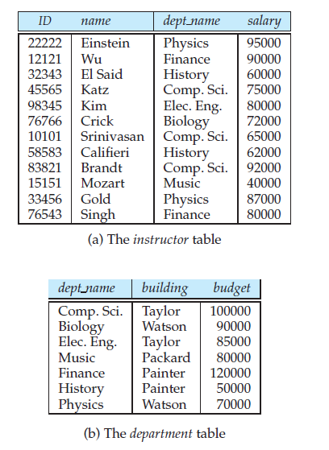
RELATIONAL DATABASES
A relational database is based on the relational model and uses a collection of tables to represent both data and the relationships among those data. It also includes a DML and DDL.
Y.GnyanaDeepa

Slide 60
RELATIONAL DATABASES
Tables
Each table has multiple columns and each column has a unique name.
The relational model is an example of a record-based model.
Record-based models are so named because the database is structured in fixed-format records of several types.
Each table contains records of a particular type. Each record type defines a fixed number of fields, or attributes.
The columns of the table correspond to the attributes of the record type.
Y.GnyanaDeepa

Slide 61
RELATIONAL DATABASES
Data-Manipulation Language
The SQL query language is nonprocedural. A query takes as input several tables (possibly only one) and always returns a single table.
SQL query that finds the names of all instructors in the History department:
select instructor.name
from instructor
where instructor.dept name = ’History’;
Y.GnyanaDeepa

Slide 62
RELATIONAL DATABASES
Queries may involve information from more than one table.
For instance, the following query finds the instructor ID and department name of all instructors associated with a department with budget of greater than $95,000.
select instructor.ID, department.dept name
from instructor, department
where instructor.dept name= department.dept name and department.budget > 95000;
Y.GnyanaDeepa

Slide 63
RELATIONAL DATABASES
Data-Definition Language
SQL provides a rich DDL that allows one to define tables, integrity constraints, assertions, etc.
For instance, the following SQL DDL statement defines the department table:
create table department
(
dept name char (20),
building char (15),
Budget varchar (12)
);
Y.GnyanaDeepa

Slide 64
RELATIONAL DATABASES
Database Access from Application Programs
Application programs are programs that are used to interact with the database.
SQL is not as powerful as a universal Turing machine; that is, there are some computations that are possible using a general-purpose programming language but are not possible using SQL.
SQL also does not support actions such as input from users, output to displays, or communication over the network.
Such computations and actions must be written in a host language, such as C, C++, or Java, with embedded SQL queries that access the data in the database.
Y.GnyanaDeepa

Slide 65
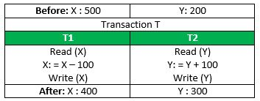
TRANSACTION MANAGEMENT
A transaction is a single logical unit of work which accesses and possibly modifies the contents of a database. Transactions access data using read and write operations.
Y.GnyanaDeepa

Slide 66
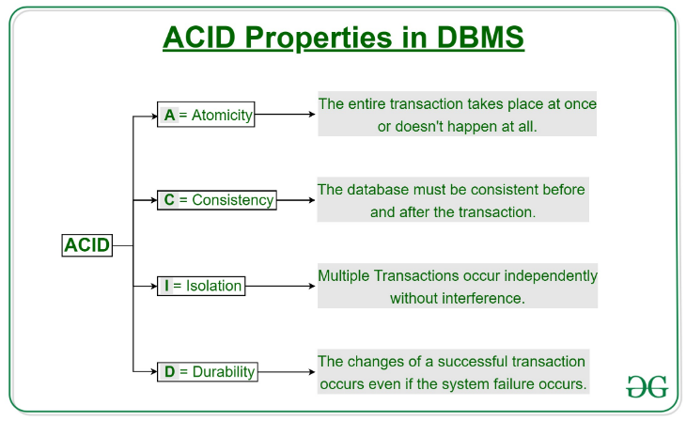
TRANSACTION MANAGEMENT
Y.GnyanaDeepa

Slide 67
TRANSACTION MANAGEMENT
Ensuring the atomicity and durability properties is the responsibility of the database system itself—specifically, of the recovery manager.
The database system must perform failure recovery, that is, detect system failures and restore the database to the state that existed prior to the occurrence of the failure.
Y.GnyanaDeepa

Slide 68
TRANSACTION MANAGEMENT
Finally, when several transactions update the database concurrently, the consistency of data may no longer be preserved, even though each individual transaction is correct.
It is the responsibility of the concurrency-control manager to control the interaction among the concurrent transactions, to ensure the consistency of the database.
The transaction manager consists of the concurrency-control manager and the recovery manager.
Y.GnyanaDeepa

Slide 69
DATA MINING AND INFORMATION RETRIEVAL
Data mining deals with “knowledge discovery in databases.”
Data mining refers to the process of semi automatically analyzing large databases to find useful patterns.
Like knowledge discovery in artificial intelligence (also called machine learning) or statistical analysis, data mining attempts to discover rules and patterns from data.
Y.GnyanaDeepa

Slide 70
DATA MINING AND INFORMATION RETRIEVAL
Some types of knowledge discovered from a database can be represented by a set of rules.
“Young women with annual incomes greater than $50,000 are the most likely people to buy small sports cars.”
There are a variety of possible types of patterns that may be useful, and different techniques are used to find different types of patterns.
Y.GnyanaDeepa

Slide 71
DATA MINING AND INFORMATION RETRIEVAL
Usually there is a manual component to data mining, consisting of pre-processing data to a form acceptable to the algorithms, and post processing of discovered patterns to find novel ones that could be useful.
There may also be more than one type of pattern that can be discovered from a given database, and manual interaction may be needed to pick useful types of patterns.
Y.GnyanaDeepa

Slide 72
DATA MINING AND INFORMATION RETRIEVAL
Businesses have begun to exploit the burgeoning data online to make better decisions about their activities, such as what items to stock and how best to target customers to increase sales.
Several techniques and tools are available to help with decision support.
Several tools for data analysis allow analysts to view data in different ways.
Y.GnyanaDeepa

Slide 73
DATA MINING AND INFORMATION RETRIEVAL
Large companies have diverse sources of data that they need to use for making business decisions.
To execute queries efficiently on such diverse data, companies have built data warehouses. Data warehouses gather data from multiple sources under a unified schema, at a single site. Thus, they provide the user a single uniform interface to data.
Y.GnyanaDeepa

Slide 74
DATA MINING AND INFORMATION RETRIEVAL
Textual data, too, has grown explosively. Textual data is unstructured, unlike the rigidly structured data in relational databases.
Querying of unstructured textual data is referred to as information retrieval.
Information retrieval systems have much in common with database systems—in particular, the storage and retrieval of data on secondary storage.
Y.GnyanaDeepa

Slide 75
DATABASE DESIGN
Database systems are designed to manage large bodies of information.
Database design mainly involves the design of the database schema.
1. Design Process
2.Database Design for a University Organization
3. The Entity-Relationship Model
4. Normalization
Y.GnyanaDeepa

Slide 76
DESIGN PROCESS
The initial phase of database design, then, is to characterize fully the data needs of the prospective database users.
The database designer needs to interact extensively with domain experts and users to carry out this task.
The outcome of this phase is a specification of user requirements.
Y.GnyanaDeepa

Slide 77
DESIGN PROCESS
Next, the designer chooses a data model, and by applying the concepts of the chosen data model, translates these requirements into a conceptual schema of the database.
The designer reviews the schema to confirm that all data requirements are indeed satisfied and are not in conflict with one another.
The designer can also examine the design to remove any redundant features.
Y.GnyanaDeepa

Slide 78
DESIGN PROCESS
In terms of the relational model, the conceptual-design process involves decisions on what attributes we want to capture in the database and how to group these attributes to form the various tables.
“what” part is basically a business decision,
and
“how” part is mainly a computer-science problem.
Y.GnyanaDeepa

Slide 79
DESIGN PROCESS
A fully developed conceptual schema indicates the functional requirements of the enterprise.
In a specification of functional requirements, users describe the kinds of operations (or transactions) that will be performed on the data.
Y.GnyanaDeepa

Slide 80
DESIGN PROCESS
The process of moving from an abstract data model to the implementation of the database proceeds in two final design phases.
In the logical-design phase, the designer maps the high-level conceptual schema onto the implementation data model of the database system that will be used.
The designer uses the resulting system-specific database schema in the subsequent physical-design phase, in which the physical features of the database are specified.
Y.GnyanaDeepa

Slide 81
DATABASE DESIGN FOR A UNIVERSITY ORGANIZATION
The initial specification of user requirements may be based on interviews with the database users, and on the designer’s own analysis of the organization.
The university is organized into departments. Each department is identified by a unique name (dept name), is located in a particular building, and has a budget.
Each department has a list of courses it offers. Each course has associated with it a course id, title, dept name, and credits, and may also have associated prerequisites.
Y.GnyanaDeepa

Slide 82
DATABASE DESIGN FOR A UNIVERSITY ORGANIZATION
In designing a database schema, we must ensure that we avoid two major pitfalls:
Redundancy: A bad design may repeat information.
The biggest problem with such redundant representation of information is that the copies of a piece of information can become inconsistent if the information is updated without taking precautions to update all copies of the information.
Y.GnyanaDeepa

Slide 83
DATABASE DESIGN FOR A UNIVERSITY ORGANIZATION
Incompleteness: A bad design may make certain aspects of the enterprise difficult or impossible to model.
Example:
Bank Database design stores customer information with account and loan.
Y.GnyanaDeepa

Slide 84
NORMALIZATION
Another method for designing a relational database is to use a process commonly known as normalization.
The goal is to generate a set of relation schemas that allows us to store information without unnecessary redundancy, yet also allows us to retrieve information easily.
The approach is to design schemas that are in an appropriate normal form.
Y.GnyanaDeepa

Slide 85
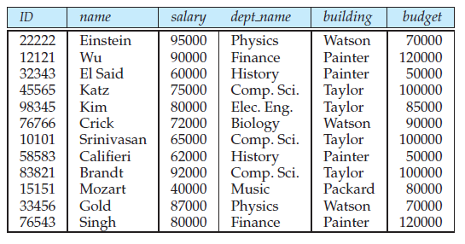
NORMALIZATION
Suppose that instead of having the two separate tables instructor and department, we have a single table, faculty, that combines the information from the two tables.
Y.GnyanaDeepa

Slide 86
THE ENTITY-RELATIONSHIP MODEL
The entity-relationship (E-R) data model uses a collection of basic objects, called entities, and relationships among these objects.
An entity is a “thing” or “object” in the real world that is distinguishable from other objects.
Entities are described in a database by a set of attributes.
A relationship is an association among several entities.
For example, a member relationship associates an instructor with her department.
Y.GnyanaDeepa

Slide 87
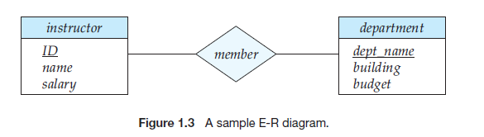
THE ENTITY-RELATIONSHIP MODEL
Y.GnyanaDeepa

Slide 88
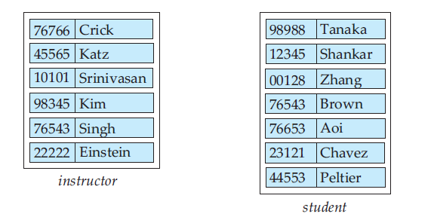
THE ENTITY-RELATIONSHIP MODEL
Y.GnyanaDeepa

Slide 89
THE ENTITY-RELATIONSHIP MODEL
Relationship Sets:
A relationship is an association among several entities.
Example:
Hayes depositor A-102
customer entity relationship set account entity
A relationship set is a mathematical relation among n ≥ 2 entities, each taken from entity sets
{(e₁, e₂, … e_{n}) | e₁ ∈ E₁, e₂ ∈ E₂, …, e_{n} ∈ E_{n}}
where (e₁, e₂, …, e_{n}) is a relationship
Y.GnyanaDeepa

Slide 90
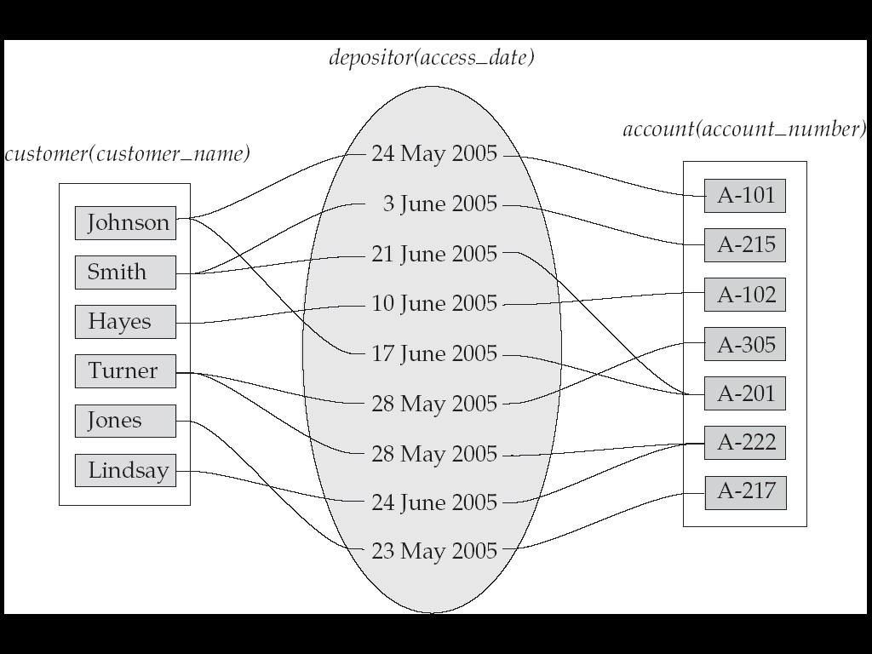
THE ENTITY-RELATIONSHIP MODEL
A relationship may also have attributes called descriptive attributes.
The depositor relationship set between entity sets customer and account may have the attribute access-date.
Y.GnyanaDeepa

Slide 91
THE ENTITY-RELATIONSHIP MODEL
The number of entity sets that participate in a relationship set is the degree of the relationship set.
A binary relationship set is of degree 2;
Y.GnyanaDeepa

Slide 92
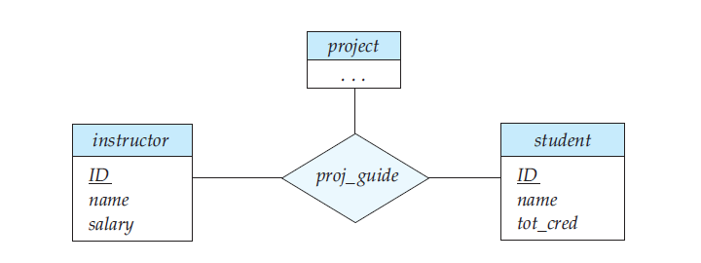
THE ENTITY-RELATIONSHIP MODEL
Y.GnyanaDeepa

Slide 93
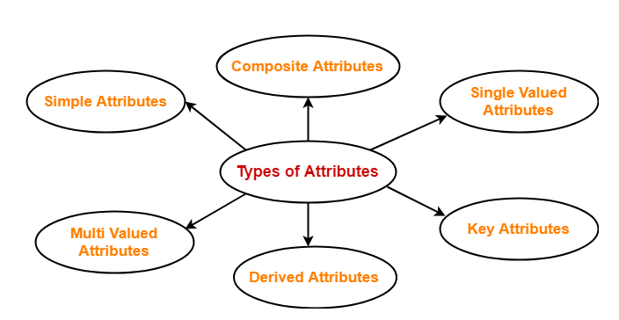
THE ENTITY-RELATIONSHIP MODEL
Attributes:
An attribute is a property or characteristic of an entity. An entity may contain any number of attributes.
Y.GnyanaDeepa

Slide 94
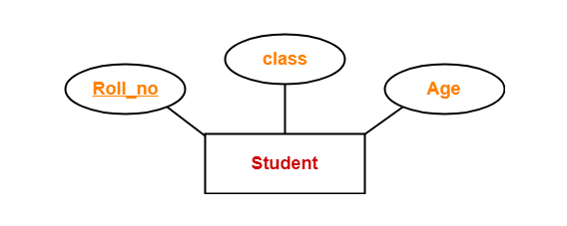
THE ENTITY-RELATIONSHIP MODEL
Simple Attributes-
Simple attributes are those attributes which can not be divided further.
Y.GnyanaDeepa

Slide 95
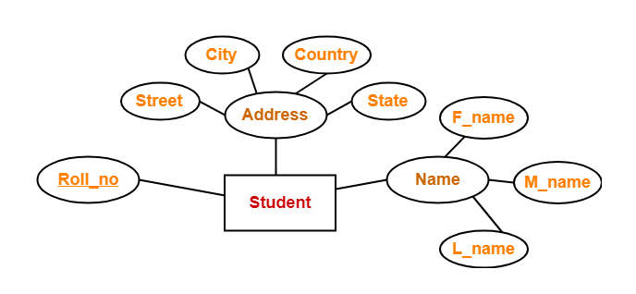
THE ENTITY-RELATIONSHIP MODEL
Composite Attributes-
Composite attributes are those attributes which are composed of many other simple attributes.
Y.GnyanaDeepa

Slide 96
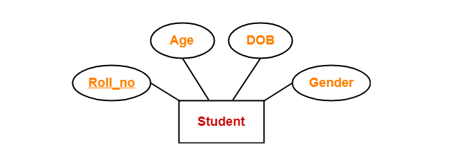
THE ENTITY-RELATIONSHIP MODEL
Single Valued Attributes-
Single valued attributes are those attributes which can take only one value for a given entity from an entity set.
Y.GnyanaDeepa

Slide 97
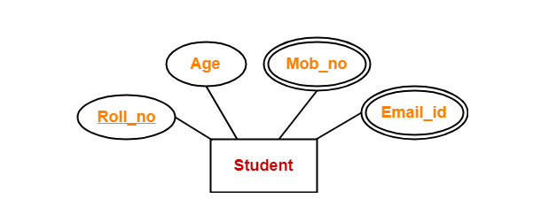
THE ENTITY-RELATIONSHIP MODEL
Multi Valued Attributes-
Multi valued attributes are those attributes which can take more than one value for a given entity from an entity set.
Y.GnyanaDeepa

Slide 98
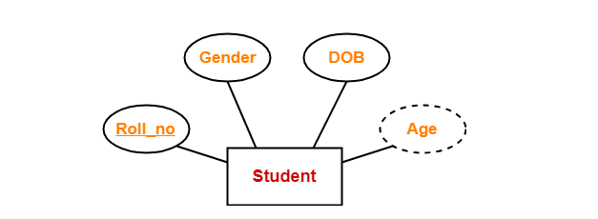
THE ENTITY-RELATIONSHIP MODEL
Derived Attributes-
Derived attributes are those attributes which can be derived from other attribute(s).
Y.GnyanaDeepa

Slide 99
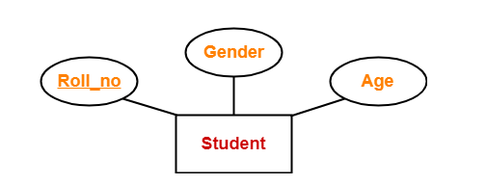
THE ENTITY-RELATIONSHIP MODEL
Key Attributes-
Key attributes are those attributes which can identify an entity uniquely in an entity set.
Y.GnyanaDeepa

Slide 100
THE ENTITY-RELATIONSHIP MODEL
Mapping Cardinality Constraints:
Mapping cardinalities, or cardinality ratios, express the number of entities to which another entity can be associated via a relationship set.
For a binary relationship set R between entity sets A and B, the mapping cardinality must be one among the 4 types.
Y.GnyanaDeepa

Slide 101
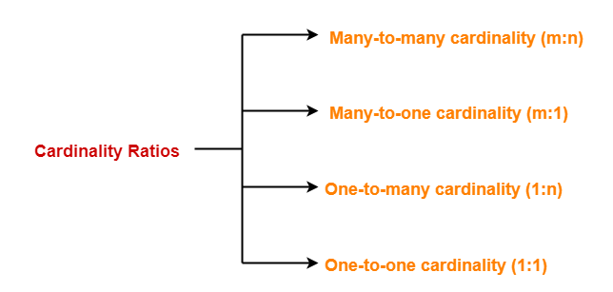
THE ENTITY-RELATIONSHIP MODEL
Y.GnyanaDeepa

Slide 102
THE ENTITY-RELATIONSHIP MODEL
One-to-one.
An entity in A is associated with at most one entity in B, and an entity in B is associated with at most one entity in A.
One-to-many.
An entity in A is associated with any number (zero or more) of entities in B. An entity in B, however, can be associated with at most one entity in A.
Y.GnyanaDeepa

Slide 103
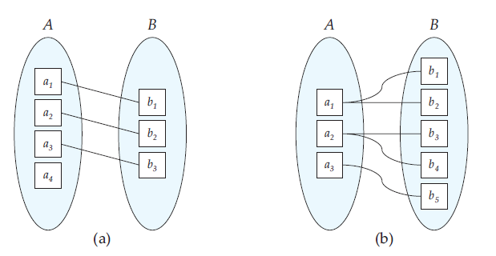
THE ENTITY-RELATIONSHIP MODEL
Y.GnyanaDeepa

Slide 104
THE ENTITY-RELATIONSHIP MODEL
Many-to-one.
An entity in A is associated with at most one entity in B. An entity in B, however, can be associated with any number (zero or more) of entities in A.
Many-to-many.
An entity in A is associated with any number (zero or more) of entities in B, and an entity in B is associated with any number (zero or more) of entities in A.
Y.GnyanaDeepa

Slide 105
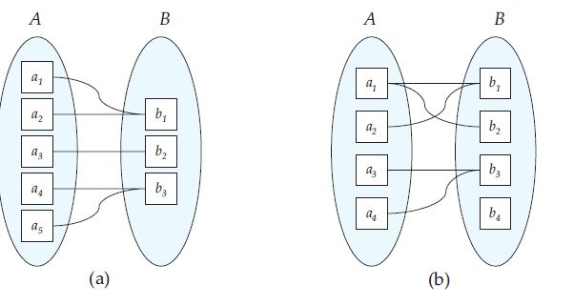
THE ENTITY-RELATIONSHIP MODEL
Y.GnyanaDeepa

Slide 106
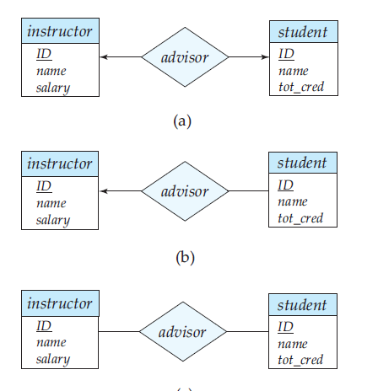
THE ENTITY-RELATIONSHIP MODEL
Y.GnyanaDeepa

Slide 107
THE ENTITY-RELATIONSHIP MODEL
Participation Constraints
The participation of an entity set E in a relationship set R is said to be total if every entity in E participates in at least one relationship in R.
participation of student in the relationship set advisor is total.
Y.GnyanaDeepa

Slide 108
THE ENTITY-RELATIONSHIP MODEL
If only some entities in E participate in relationships in R, the participation of entity set E in relationship R is said to be partial.
participation of instructor in the advisor relationship set is partial.
Y.GnyanaDeepa

Slide 109
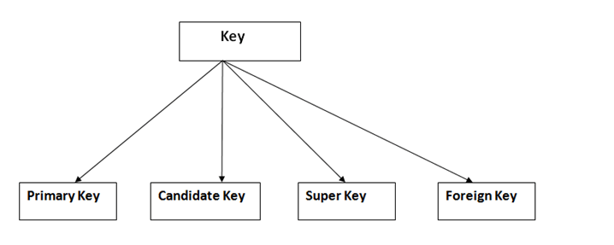
THE ENTITY-RELATIONSHIP MODEL
Keys
Keys play an important role in the relational database.
It is used to uniquely identify any record or row of data from the table. It is also used to establish and identify relationships between tables.
Y.GnyanaDeepa

Slide 110
THE ENTITY-RELATIONSHIP MODEL
Keys
The primary key of an entity set allows us to distinguish among the various entities of the set.
We need a similar mechanism to distinguish among the various relationships of a relationship set.
Let R be a relationship set involving entity sets E1, E2, . . . , En. Let primary key(Ei ) denote the set of attributes that forms the primary key for entity set Ei .
Y.GnyanaDeepa

Slide 111
THE ENTITY-RELATIONSHIP MODEL
Keys
If the relationship set R has no attributes associated with it, then the set of attributes
primary-key(E1) ∪ primary-key(E2) ∪ ·· · ∪ primary-key(En)
describes an individual relationship in set R.
If the relationship set R has attributes a1, a2, . . . , am associated with it, then the set of attributes
primary-key(E1) ∪ primary-key(E2) ∪ · · · ∪ primary-key(En) ∪ {a1, a2, . . . , am}
describes an individual relationship in set R.
Y.GnyanaDeepa

Slide 112
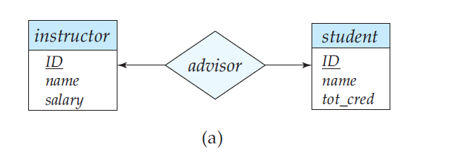
THE ENTITY-RELATIONSHIP MODEL
CASE 1
The entity sets instructor and student, and the relationship set advisor, with attribute date.
Suppose that the relationship set is many-to-many. Then the primary key of advisor consists of the union of the primary keys of instructor and student.
Y.GnyanaDeepa

Slide 113
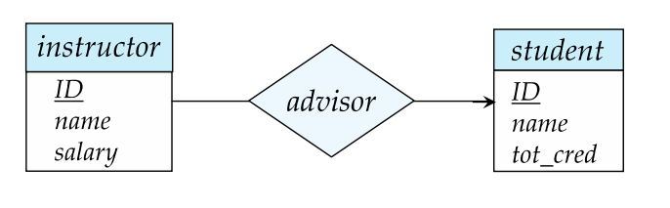
THE ENTITY-RELATIONSHIP MODEL
CASE 2
If the relationship is many-to-one from student to instructor—that is, each student can have have at most one advisor—then the primary key of advisor is simply the primary key of student.
Y.GnyanaDeepa

Slide 114
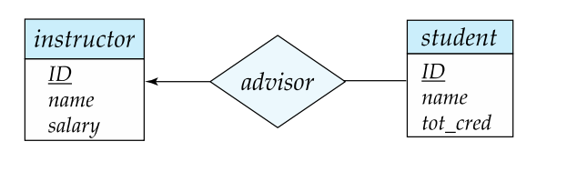
THE ENTITY-RELATIONSHIP MODEL
CASE 3
if an instructor can advise only one student that is, if the advisor relationship is many-to-one from instructor to student—then the primary key of advisor is simply the primary key of instructor.
For one-to-one relationships either candidate key can be used as the primary key.
Y.GnyanaDeepa

Slide 115
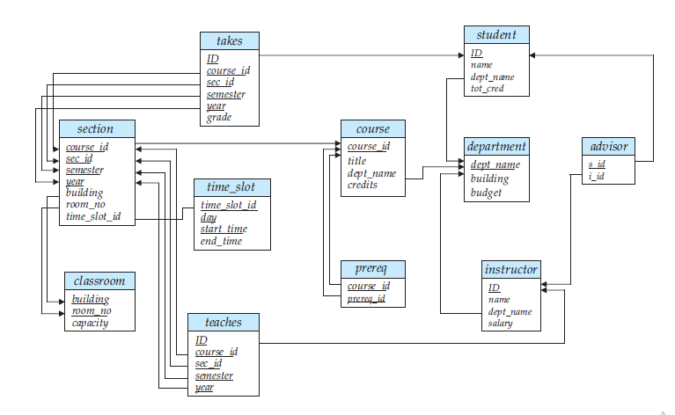
THE ENTITY-RELATIONSHIP MODEL
Y.GnyanaDeepa

Slide 116
THE ENTITY-RELATIONSHIP MODEL
Removing Redundant Attributes in Entity Sets
CASE 1
The entity set instructor includes the attributes ID, name, dept name, and salary, with ID forming the primary key.
The entity set department includes the attributes dept name, building, and budget, with dept name forming the primary key.
Y.GnyanaDeepa

Slide 117
THE ENTITY-RELATIONSHIP MODEL
Removing Redundant Attributes in Entity Sets
CASE 1
The attribute dept name appears in both entity sets. Since it is the primary key for the entity set department, it is redundant in the entity set instructor and needs to be removed.
Similarly, the student entity set is related to the department entity set through the relationship set student dept and thus there is no need for a dept name attribute in student.
Y.GnyanaDeepa

Slide 118
THE ENTITY-RELATIONSHIP MODEL
Removing Redundant Attributes in Entity Sets
CASE 2
The entity set section includes the attributes course id, sec id, semester, year, building, room number, and time slot id, with (course id, sec id, year, semester) forming the primary key.
The entity set time slot includes the attributes time slot id, which is the primary key,and a multivalued composite attribute {(day, start time, end time)}.
Y.GnyanaDeepa

Slide 119
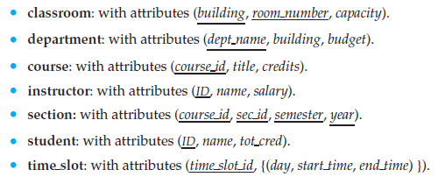
THE ENTITY-RELATIONSHIP MODEL
Y.GnyanaDeepa

Slide 120
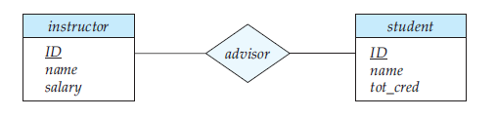
THE ENTITY-RELATIONSHIP MODEL
Entity-Relationship Diagrams
Basic Structure:
Y.GnyanaDeepa

Slide 121
THE ENTITY-RELATIONSHIP MODEL
Entity-Relationship Diagrams
Rectangles divided into two parts represent entity sets. The first part, which contains the name of the entity set. The second part contains the names of all the attributes of the entity set.
Diamonds represent relationship sets.
Undivided rectangles represent the attributes of a relationship set.
Attributes that are part of the primary key are underlined.
Lines link entity sets to relationship sets.
Double lines indicate total participation of an entity in a relationship set.
Double diamonds represent identifying relationship sets linked to weak entity sets
Y.GnyanaDeepa

Slide 122
THE ENTITY-RELATIONSHIP MODEL
E-R diagrams also provide a way to indicate more complex constraints on the number of times each entity participates in relationships in a relationship set.
A line may have an associated minimum and maximum cardinality, form l..h.
where l is the minimum and h the maximum cardinality.
Y.GnyanaDeepa

Slide 123
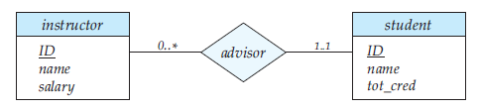
THE ENTITY-RELATIONSHIP MODEL
The line between advisor and student has a cardinality constraint of 1..1, meaning the minimum and the maximum cardinality are both 1.
That is, each student must have exactly one advisor. The limit 0..∗ on the line between advisor and instructor indicates that an instructor can have zero or more students.
Y.GnyanaDeepa

Slide 124
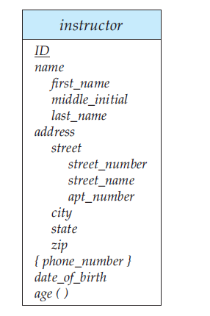
THE ENTITY-RELATIONSHIP MODEL
Complex Attributes
Y.GnyanaDeepa

Slide 125
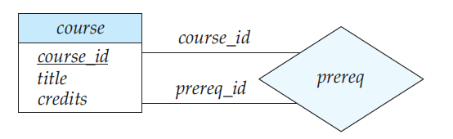
THE ENTITY-RELATIONSHIP MODEL
Roles
We indicate roles in E-R diagrams by labelling the lines that connect diamonds to rectangles.
Y.GnyanaDeepa

Slide 126
THE ENTITY-RELATIONSHIP MODEL
Weak Entity Sets
An entity set that does not have sufficient attributes to form a primary key is termed a weak entity set.
An entity set that has a primary key is termed a strong entity set.
For a weak entity set to be meaningful, it must be associated with another entity set, called the identifying or owner entity set.
The relationship associating the weak entity set with the identifying entity set is called the identifying relationship.
Y.GnyanaDeepa

Slide 127
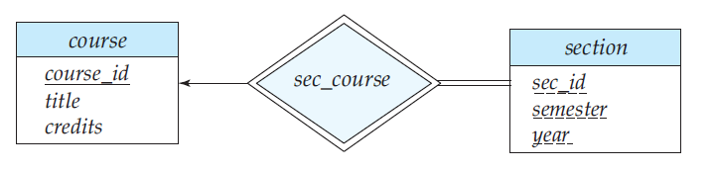
THE ENTITY-RELATIONSHIP MODEL
Weak Entity Sets
Y.GnyanaDeepa

Slide 128
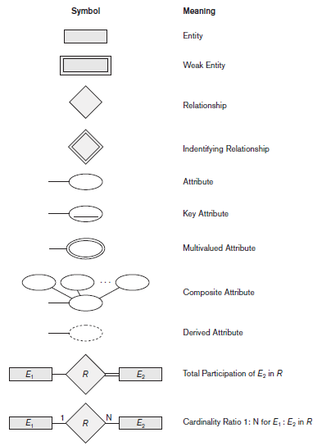
THE ENTITY-RELATIONSHIP MODEL
Y.GnyanaDeepa

Slide 129
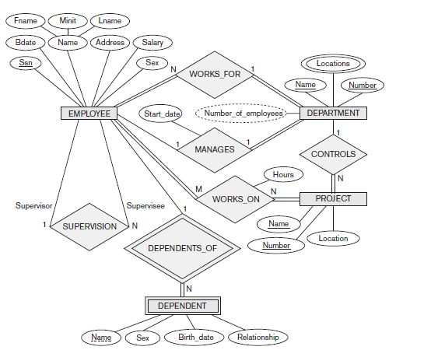
THE ENTITY-RELATIONSHIP MODEL
Y.GnyanaDeepa

Slide 130
ENTITY-RELATIONSHIP DESIGN ISSUES
Use of Entity Sets versus Attributes
Use of Entity Sets versus Relationship Sets
Binary versus n-ary Relationship Sets
Placement of Relationship Attributes
Y.GnyanaDeepa

Slide 131
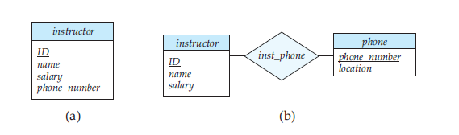
ENTITY-RELATIONSHIP DESIGN ISSUES
Use of Entity Sets versus Attributes
It can easily be argued that a phone is an entity in its own right with attributes phone number and location; the location may be the office or home where the phone is located.
Y.GnyanaDeepa

Slide 132
ENTITY-RELATIONSHIP DESIGN ISSUES
Use of Entity Sets versus Attributes
A phone entity set with attributes phone number and location.
A relationship set inst_phone, denoting the association between instructors and the phones that they have.
Two natural questions thus arise:
What constitutes an attribute?
What constitutes an entity set?
The distinctions mainly depend on the structure of the real-world enterprise being modelled , and on the semantics associated with the attribute in question.
Y.GnyanaDeepa

Slide 133
ENTITY-RELATIONSHIP DESIGN ISSUES
Use of Entity Sets versus Relationship Sets
It is not always clear whether an object is best expressed by an entity set or a relationship set.
Y.GnyanaDeepa
SALE
ITEM
Customer
IID
CID
Date

Slide 134
ENTITY-RELATIONSHIP DESIGN ISSUES
Use of Entity Sets versus Relationship Sets
ITEM
Customer
Y.GnyanaDeepa
QTY
INVOICE
IID
CID
Date

Slide 135
ENTITY-RELATIONSHIP DESIGN ISSUES
Binary versus n-ary Relationship Sets
Relationships in databases are often binary. Some relationships that appear to be non binary could actually be better represented by several binary relationships.
Y.GnyanaDeepa
CHILD
PARENT
FATHER
MOTHER

Slide 136
ENTITY-RELATIONSHIP DESIGN ISSUES
Binary versus n-ary Relationship Sets
CHILD
C-M
C-F
Y.GnyanaDeepa
FATHER
MOTHER

Slide 137
ENTITY-RELATIONSHIP DESIGN ISSUES
Binary versus n-ary Relationship Sets
Consider the abstract ternary (n = 3) relationship set R, relating entity sets A, B, and C.
We replace the relationship set R by an entity set E, and create three relationship sets.
RA, relating E and A.
RB, relating E and B.
RC, relating E and C.
Y.GnyanaDeepa

Slide 138
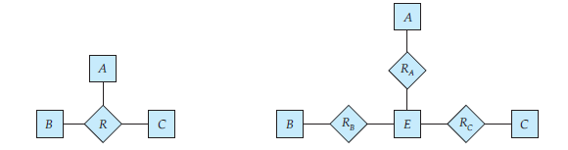
ENTITY-RELATIONSHIP DESIGN ISSUES
Binary versus n-ary Relationship Sets
Create artificial entity set.------------1
RA, relating E and A.
RB, relating E and B. ---------2
RC, relating E and C.
Y.GnyanaDeepa

Slide 139
ENTITY-RELATIONSHIP DESIGN ISSUES
Binary versus n-ary Relationship Sets
Create special Identifying Attribute.------------3
Add any Attribute of R to E---------------------------4
(ei , ai) in RA.
(ei , bi) in RB. _________________5
(ei , ci) in RC.
Y.GnyanaDeepa

Slide 140
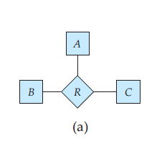
ENTITY-RELATIONSHIP DESIGN ISSUES
Binary versus n-ary Relationship Sets
Y.GnyanaDeepa
A
a1
a2
a3
a4
B
b1
b2
b3
b4
C
c1
c2
c3
c4
R
a1,b1,c1
a2,b2,c2
a3,b3,c3
a4,b4,c4

Slide 141
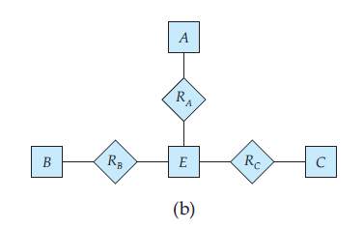
ENTITY-RELATIONSHIP DESIGN ISSUES
Binary versus n-ary Relationship Sets
Y.GnyanaDeepa
E
e1
e2
e3
e4
Ra
e1,a1
e2,a2
e3,a3
e4,a4
RB
e1,b1
e2,b2
e3,b3
e4,b4
RC
e1,c1
e2,c2
e3,c3
e4,c4

Slide 142
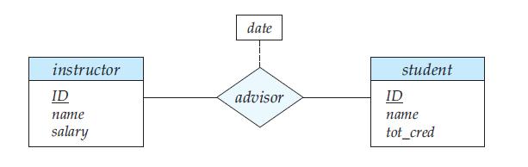
ENTITY-RELATIONSHIP DESIGN ISSUES
Placement of Relationship Attributes
The cardinality ratio of a relationship can affect the placement of relationship attributes.
1:1
Y.GnyanaDeepa

Slide 143
ENTITY-RELATIONSHIP DESIGN ISSUES
Placement of Relationship Attributes
1:N
M:N
Y.GnyanaDeepa

Slide 144
EXTENDED E-R FEATURES(EER)
Extended E-R Features:
EER is a high-level data model that incorporates the extensions to the original ER model.
Specialization
Generalization
Aggregation
Y.GnyanaDeepa

Slide 145
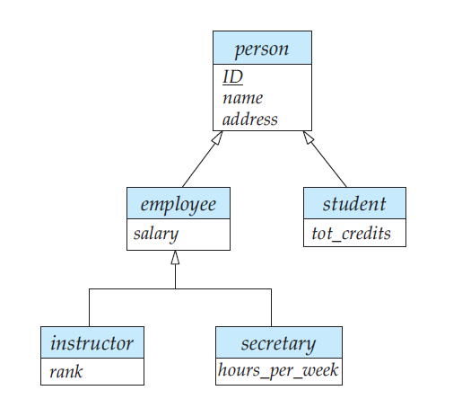
EXTENDED E-R FEATURES(EER)
Extended E-R Features:
Y.GnyanaDeepa

Slide 146
EXTENDED E-R FEATURES(EER)
Specialization
The process of designating sub groupings within an entity set is called specialization.
Specialization is a top-down approach, and it is opposite to Generalization.
In specialization, one higher level entity can be broken down into two lower level entities.
The specialization relationship may also be referred to as a superclass-subclass relationship.
Y.GnyanaDeepa

Slide 147
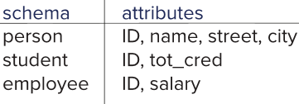
EXTENDED E-R FEATURES(EER)
Specialization
  Form a schema for the higher-level entity
  Form a schema for each lower-level entity set, include primary key of higher-level entity set and local attributes.
  Drawback: Getting information about, an employee requires accessing two relations, the one corresponding to the low-level schema and the one corresponding to the high-level schema
Y.GnyanaDeepa

Slide 148
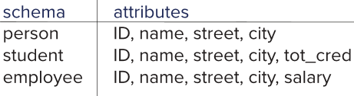
EXTENDED E-R FEATURES(EER)
Specialization
  Form a schema for each entity set with all local and inherited attributes
  Drawback: name, street and city may be stored redundantly for people who are both students and employees
Y.GnyanaDeepa

Slide 149
EXTENDED E-R FEATURES(EER)
Generalization
The design process may also proceed in a bottom-up manner, in which multiple entity sets are synthesized into a higher-level entity set on the basis of common features.
Generalization is a simple inversion of specialization.
Attribute Inheritance
A crucial property of the higher- and lower-level entities created by specialization and generalization is attribute inheritance.
The attributes of the higher-level entity sets are said to be inherited by the lower-level entity sets.
Y.GnyanaDeepa

Slide 150
EXTENDED E-R FEATURES(EER)
A higher-level entity set with attributes and relationships that apply to all of its lower-level entity sets.
Lower-level entity sets with distinctive features that apply only within a particular lower-level entity set.
In a hierarchy, a given entity set may be involved as a lower level entity set in only one ISA relationship called Single Inheritance.
If an entity set is a lower-level entity set in more than one ISA relationship, then the entity set has multiple inheritance
Y.GnyanaDeepa

Slide 151
EXTENDED E-R FEATURES(EER)
Constraints on Generalizations
Condition-defined. In condition-defined lower-level entity sets, membership is evaluated on the basis of whether or not an entity satisfies an explicit condition or predicate.
User-defined. User-defined lower-level entity sets are not constrained by a membership condition; rather, the database user assigns entities to a given entity set.
Y.GnyanaDeepa

Slide 152
EXTENDED E-R FEATURES(EER)
Disjoint. A disjointness constraint requires that an entity belong to no more than one lower-level entity set.
Overlapping. In overlapping generalizations, the same entity may belong to more than one lower-level entity set within a single generalization.
Example:
Consider the employee work-team example, and assume that certain employees participate in more than one work team.
Y.GnyanaDeepa

Slide 153
EXTENDED E-R FEATURES(EER)
Completeness constraint
Total generalization or specialization.
Each higher-level entity must belong to a lower-level entity set.
Partial generalization or specialization.
Some higher-level entities may not belong to any lower-level entity set.
Y.GnyanaDeepa

Slide 154
EXTENDED E-R FEATURES(EER)
Aggregation
One limitation of the E-R model is that it cannot express relationships among relationships.
In aggregation, the relation between two entities is treated as a single entity.
In aggregation, relationship with its corresponding entities is aggregated into a higher level entity.
Y.GnyanaDeepa

Slide 155
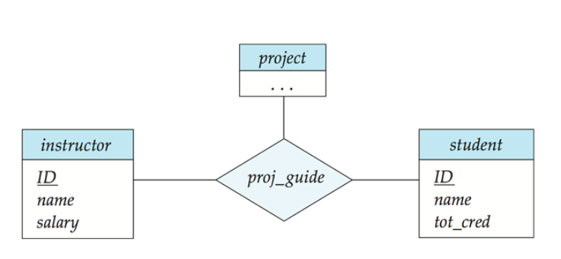
EXTENDED E-R FEATURES(EER)
Y.GnyanaDeepa

Slide 156
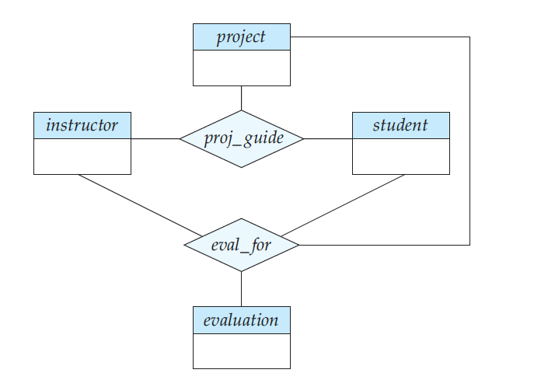
EXTENDED E-R FEATURES(EER)
Y.GnyanaDeepa

Slide 157

EXTENDED E-R FEATURES(EER)
Y.GnyanaDeepa

Slide 158

EXTENDED E-R FEATURES(EER)
Reduction to Relation Schemas
Representation of Generalization
There are two different methods of designing relation schemas for an E-R diagram that includes generalization.
M1-Create a schema for the higher-level entity set.
Y.GnyanaDeepa

Slide 159
EXTENDED E-R FEATURES(EER)
M2-
if the generalization is disjoint and complete—that is, if no entity is a member of two lower-level entity sets directly below a higher-level entity set
and
if every entity in the higher-level entity set is also a member of one of the lower-level entity sets.
Y.GnyanaDeepa

Slide 160

EXTENDED E-R FEATURES(EER)
For each lower level entity set, we create a schema that includes an attribute for each of the attributes of that entity set plus one for each attribute of the higher-level entity set.
Y.GnyanaDeepa

Slide 161

ALTERNATIVE NOTATIONS FOR MODELING DATA
Y.GnyanaDeepa

Slide 162

ALTERNATIVE NOTATIONS FOR MODELING DATA
Y.GnyanaDeepa

Slide 163
ALTERNATIVE NOTATIONS FOR MODELING DATA
The Unified Modelling Language UML
The Unified Modelling Language (UML) is a standard for creating specifications of various components of a software system.
Some of the parts of UML are:
Class diagram. E-R diagram.
Use case diagram.
Activity diagram
Implementation diagram.
Y.GnyanaDeepa

Slide 164

ALTERNATIVE NOTATIONS FOR MODELING DATA
The Unified Modelling Language UML
Y.GnyanaDeepa

